Slide 1


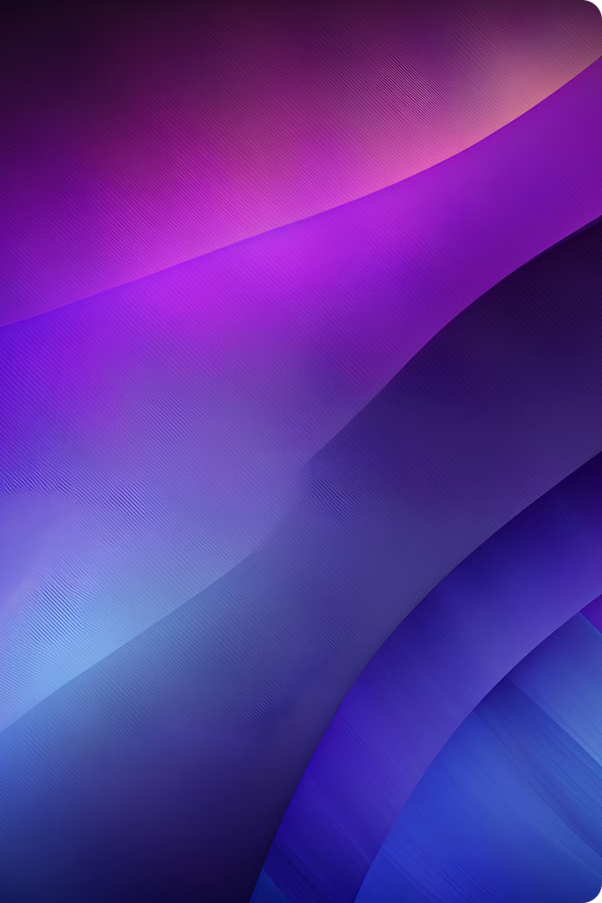
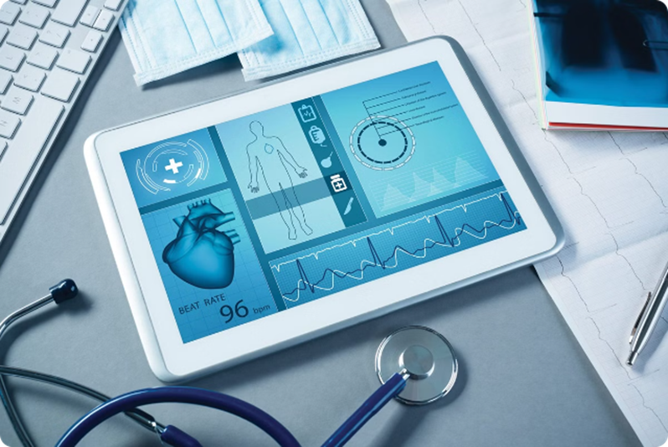
Introduction to Remote Health Monitoring System
Revolutionizing healthcare through a cutting-edge remote monitoring system that leverages advanced technologies to provide comprehensive, real-time health data and insights from the comfort of one's home. This innovative solution empowers individuals to take control of their well-being and enables healthcare providers to deliver more personalized, proactive care.

Slide 2

Overview of the Project
This comprehensive remote health monitoring system harnesses cutting-edge technologies to empower individuals and revolutionize healthcare delivery. By combining an ESP32 microcontroller, temperature and heart rate sensors, and cloud integration, the project aims to provide real-time health insights and enable proactive, personalized care from anywhere in the world.

Slide 3

Course of the Project
Research & Design
App Development and Integration
We conducted in-depth internet research to find a genuine project to design an effective solution. Then, we clarified and studied the components we needed.
The last and most important work was developing an app which could be integrated with our physical model.
1
2
3
Developing the physical model
We worked on learning the connections and doing it practically and developed a physical model as per our need.

Slide 4


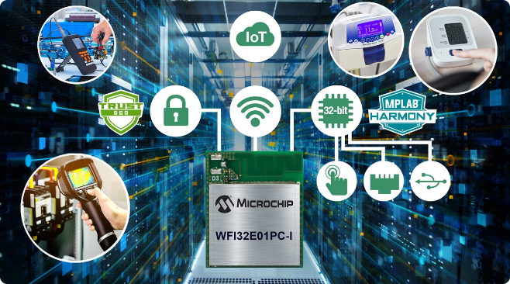
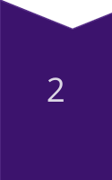
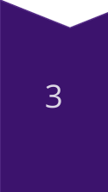
Physical Model Development
Collected Informations
After we decided our project, first of all, we gathered a variety of informative details about the components we needed, its working and its expenses.
Buying and connecting components
One of the important steps of all this was to gain knowledge about the connections and to connect the components properly.
Coding and making the model ready for use
The most important and final step was coding the ESP32 microcontroller according to our use, with implementing proper way to keep sending the data to the Blynk cloud so that it can be retrieved in our app.

Slide 5
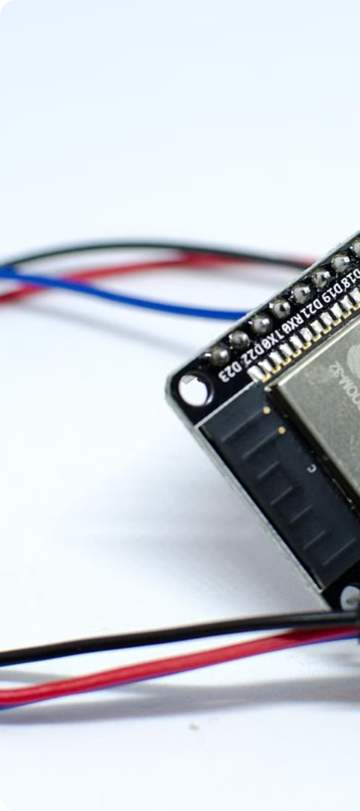
Components: ESP32, Temperature Sensor, Heart Rate Sensor
ESP32 Microcontroller
Temperature Sensor
The powerful ESP32 microcontroller serves as the brain of the remote health monitoring system, enabling seamless data collection, processing, and communication.
An digital DS18B20 temperature sensor continuously monitors the user's body temperature, providing real-time insight into their thermal regulation and overall health status.
Heart Rate Sensor
A sophisticated heart rate sensor tracks the user's pulse, allowing the system to closely monitor their cardiovascular health and detect any abnormalities.

Slide 6
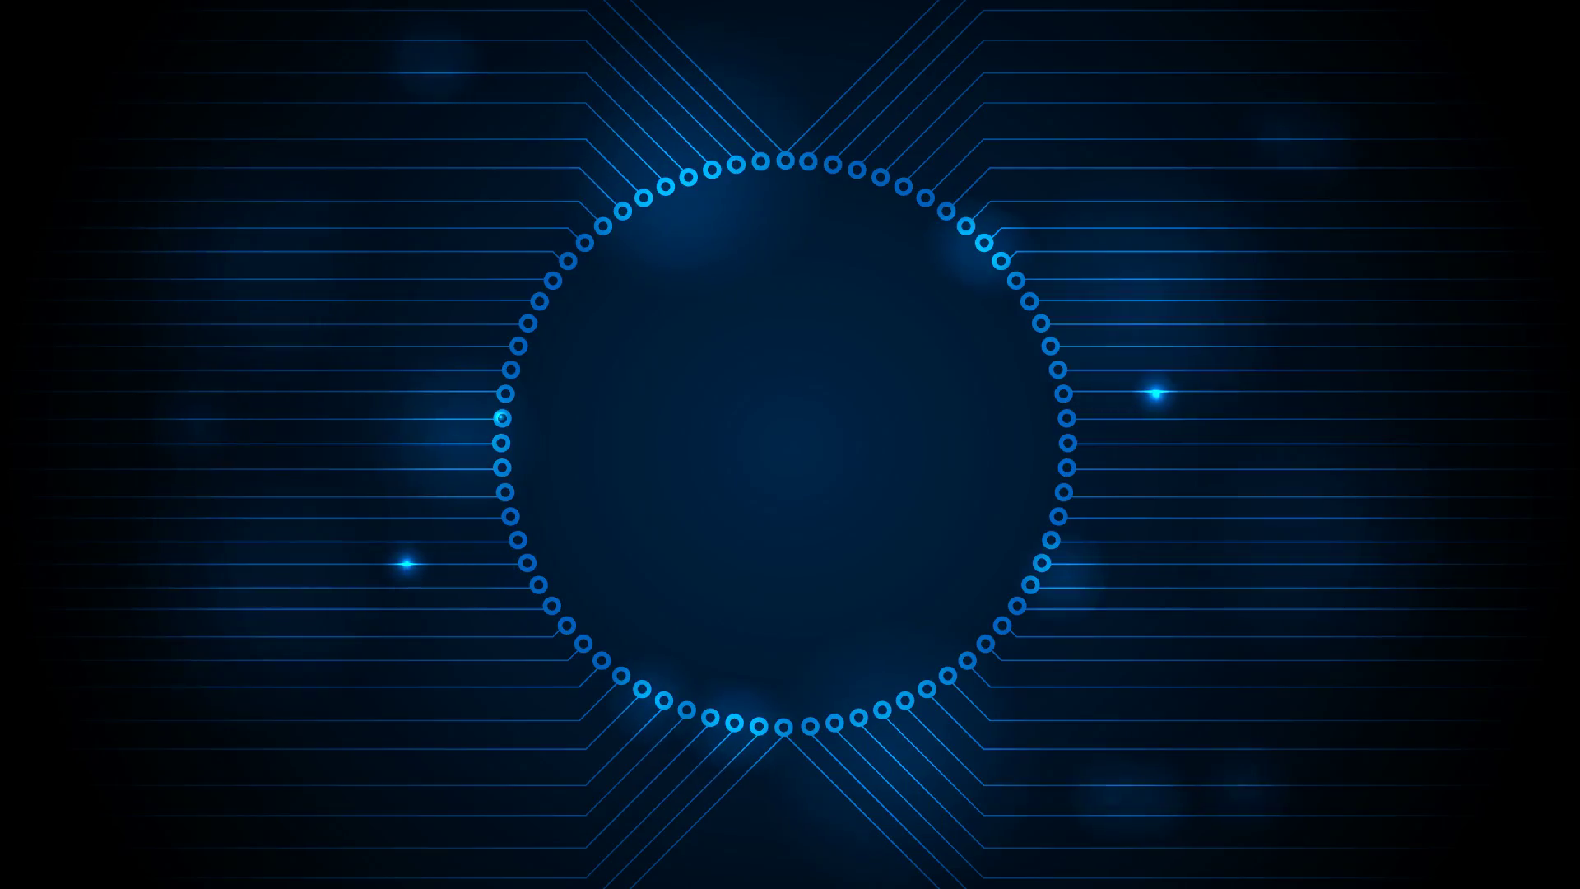
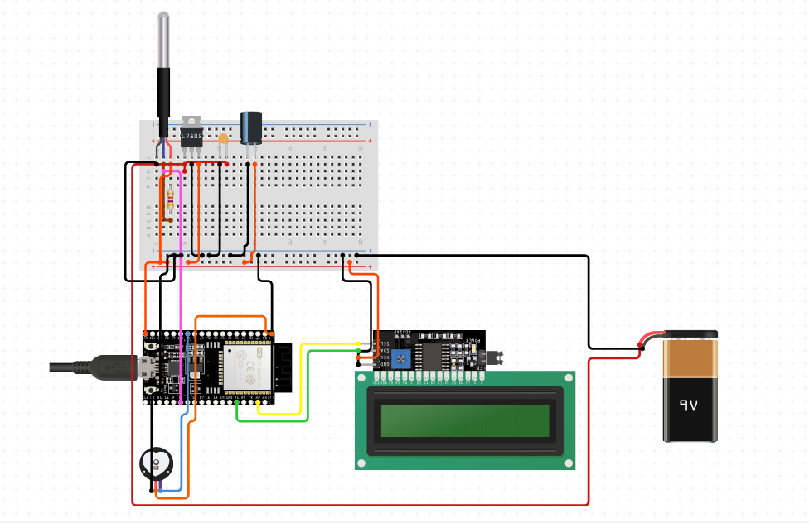
Circuit Diagram
Using a USB for testing purpose seemed to a good option, but we decided to use a battery instead so that we may increase the portability and a continuous power supply could be provided wherever necessary removing the need of USB and laptop for giving power supply anywhere.

Slide 7
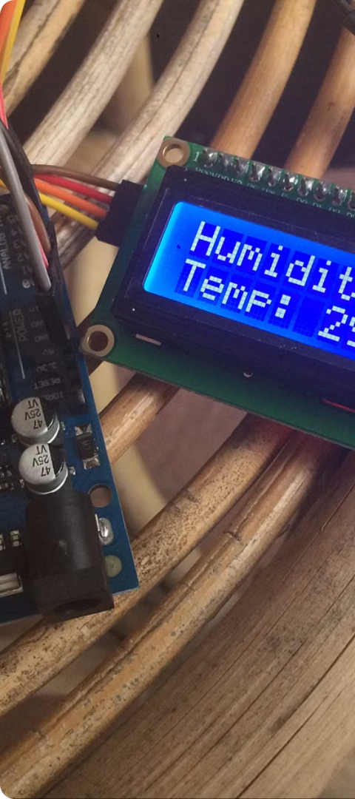
Data Collection and Display on LCD
1
Sensor Integration
The temperature and heart rate sensors seamlessly integrate with the ESP32 microcontroller, enabling real-time data collection from the user's body.
2
Onboard Processing
The powerful ESP32 chip rapidly processes the sensor data, preparing it for display and cloud transmission.
3
LCD Display
The collected health metrics are displayed in a clear, easy-to-read format on the LCD screen, allowing the user to monitor their vitals at a glance.

Slide 8



Cloud Integration for Data Storage and Retrieval
Cloud-Based Storage
1
Seamless upload of health data to secure cloud servers
2
Data Retrieval
Able to retrieve data from the mobile app and keep updating
Remote Access
3
Users can access the data from anywhere in the world
The remote health monitoring system is seamlessly integrated with cloud computing platform - Blynk, enabling secure storage and retrieval of the user's vital health data. The collected information is automatically uploaded to the cloud. This empowers healthcare providers and users to access the data remotely, supporting proactive, personalized care and empowering individuals to actively manage their well-being.

Slide 9

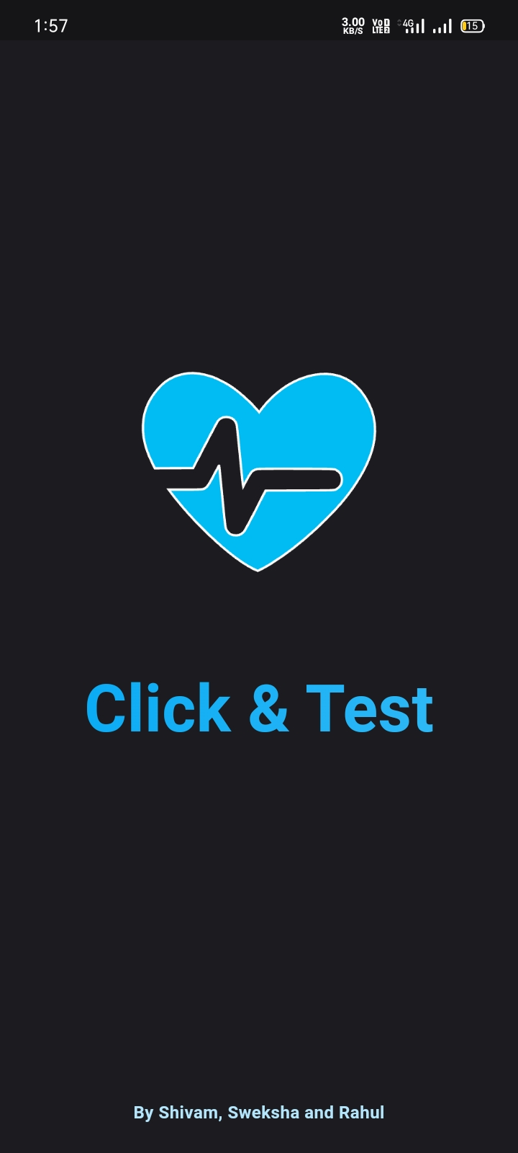
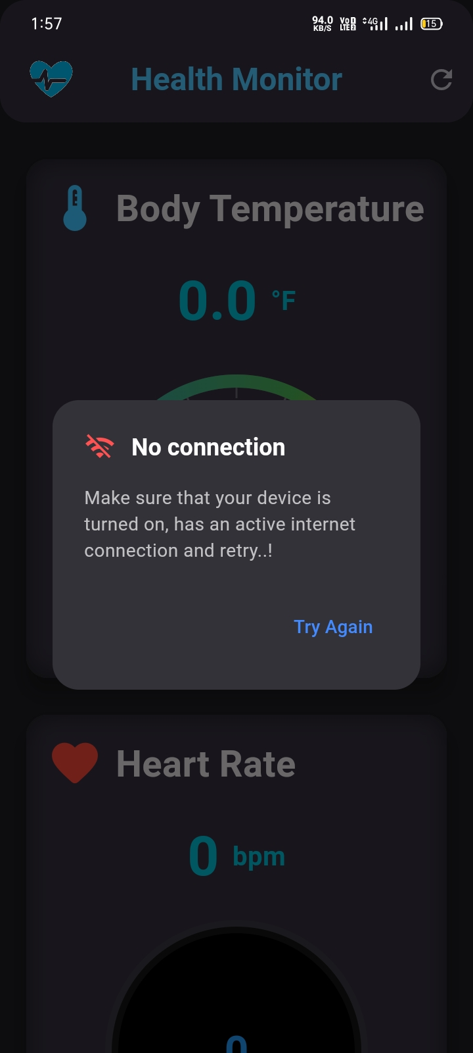
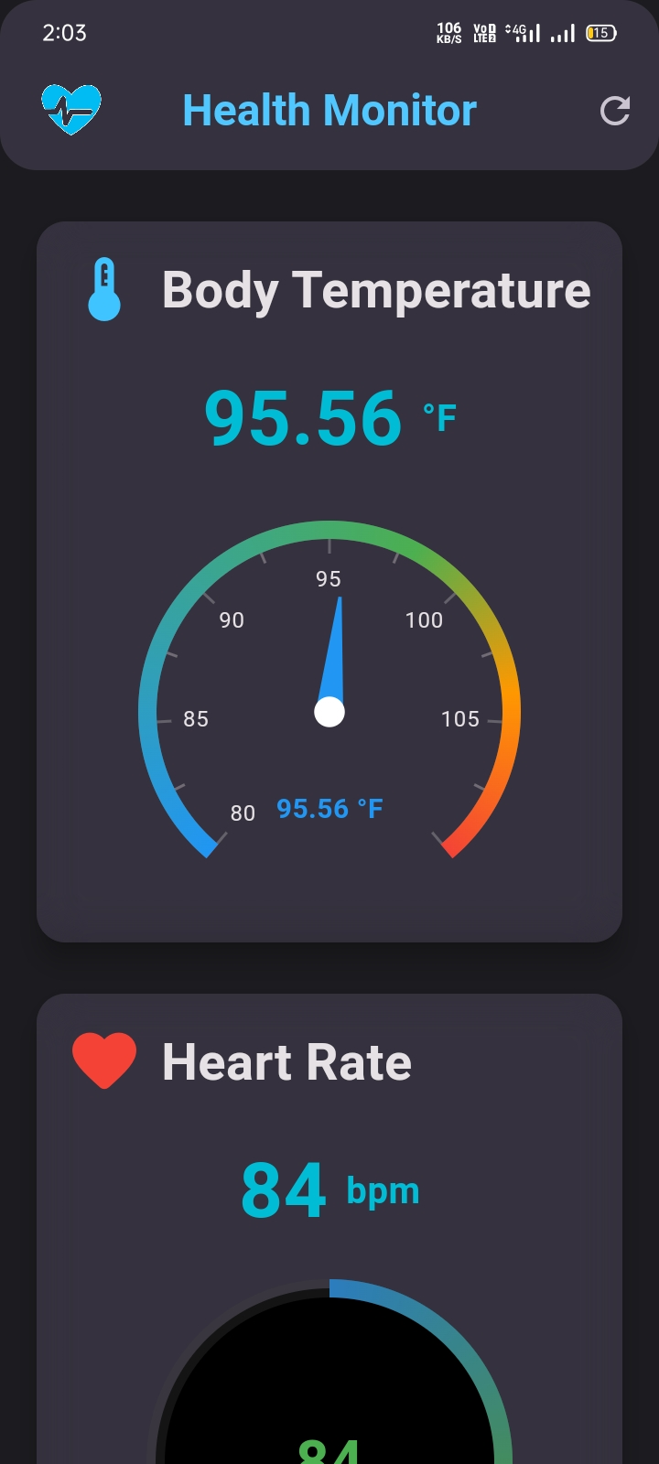
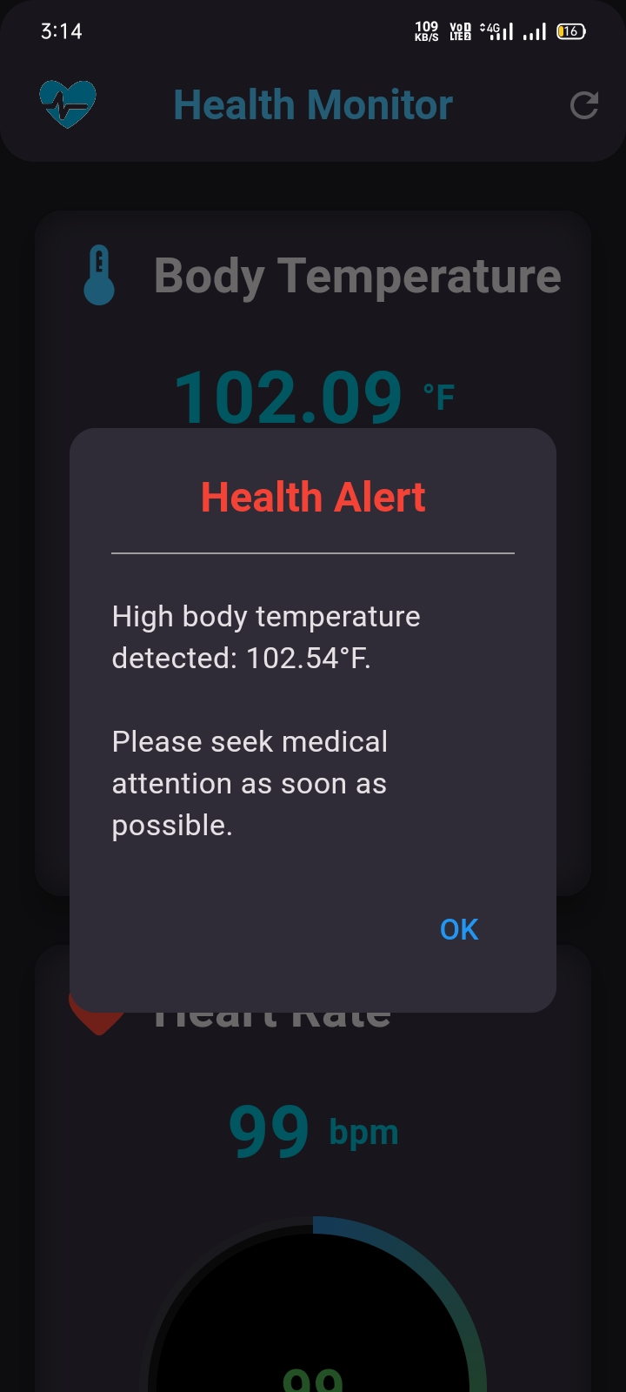
"Click and Test" Mobile App Development
Complementing the remote health monitoring system, the "Click and Test" mobile app empowers users to seamlessly access their vital health data from anywhere in the world. This intuitive application serves as a central hub, allowing users to view their real-time sensor readings and monitor their well-being with ease.
Leveraging the cloud-based data storage capabilities, the app provides users with a overview of their health, enabling them to take proactive steps towards maintaining optimal wellness. The app's user-friendly interface and personalized insights make it a valuable tool for individuals to manage their healthcare and stay connected to their medical providers.

Slide 10
'Click and Test' App - Bringing Real-time Data Visualization to Flutter
Intuitive User Interface
Real-time Monitoring
Proper data retrieval and handling
Key Features
Flutter Development
UI Design
Cloud Integration
We started the project by exploring the capabilities of Flutter, a popular open-source mobile app development framework. Flutter's cross-platform compatibility and rich widget ecosystem made it the ideal choice for creating a visually appealing and responsive app.
To enhance the user experience, we carefully selected a variety of Flutter widgets to build an intuitive and visually-engaging interface. This included using Material Design components, custom layouts, and interactive elements to present the health data in a clear and accessible manner.
To ensure people could securely access their real-time health data, we integrated the app with a Blynk cloud-based server. This allowed the app to seamlessly retrieve the latest information from the connected device and display it in a user-friendly format, empowering people to take an active role in their healthcare.

Slide 11
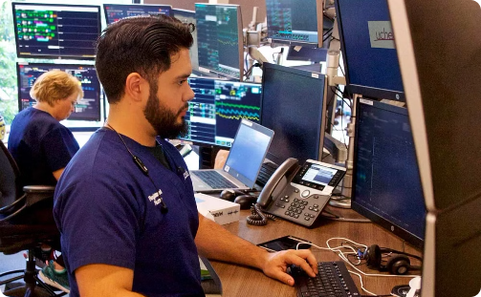
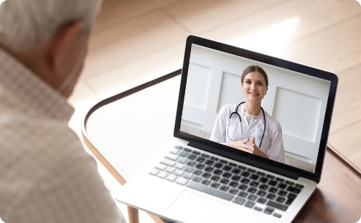

Monitoring Health from Anywhere in the World
Real-Time Data Access
Telehealth Consultations
Caregiver Connectivity
Patients can view their vital signs, such as temperature and heart rate, in real-time through the mobile app, empowering them to take an active role in managing their health.
The system seamlessly integrates with telehealth platforms, enabling patients to connect with their healthcare providers remotely for personalized consultations and care recommendations.
Authorized family members and caregivers can access the patient's health data, providing them with the ability to monitor their loved one's well-being from anywhere in the world.

Slide 12



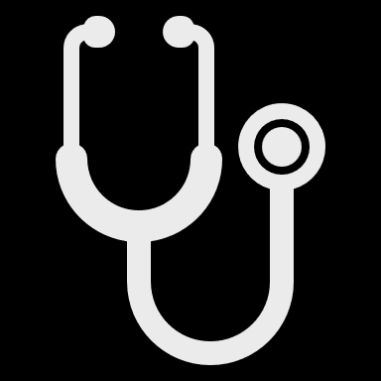
Benefits and Applications of the System
Improved Health Outcomes
Convenience and Accessibility
The remote health monitoring system enables early detection of issues, allowing for prompt intervention and better management of chronic conditions.
Patients can conveniently monitor their health from the comfort of their own homes, reducing the need for frequent in-person visits.
Cost Savings
Enhanced Patient Engagement
The system helps to reduce healthcare costs by enabling proactive care and preventing costly emergency situations.
The mobile app and remote access empower patients to take a more active role in managing their well-being.

Slide 13



Future Enhancements and Integration of Medical Tools
Advanced Sensors
AI-Powered Analytics
Integrated Telehealth
Integrating more sophisticated medical sensors to track a wider range of health metrics, from blood pressure to oxygen levels and beyond.
Leveraging cutting-edge AI algorithms to analyze patient data and provide personalized insights, predictive care recommendations, and early detection of health issues.
Seamless integration with telehealth platforms, enabling real-time consultations and virtual care delivery, fostering stronger patient-provider relationships.

Slide 14
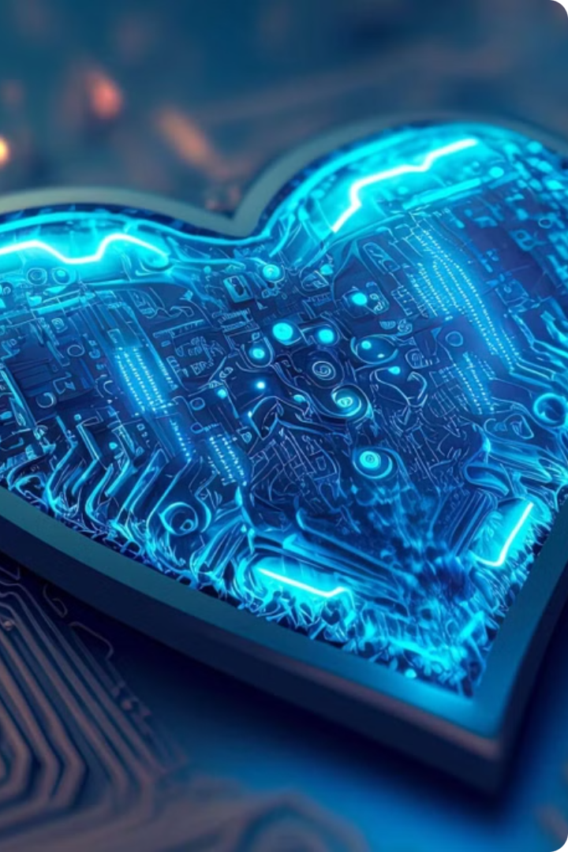
Conclusion and Summary
The remote health monitoring system we have developed represents a significant leap forward in personalized healthcare delivery. By seamlessly integrating cutting-edge technologies, this comprehensive solution empowers individuals to take an active role in managing their well-being from anywhere in the world.

